Slide 1


Optimization Methodologies for the Clustered Vehicle Routing Problem
Stamatoula Gerasimoula Mesolora
Supervisor: Emmanouil Zachariadis
Department of Management Science & Technology MSc in Business Analytics
June 2025

Slide 2
Contents
Slide 3 - Vehicle Routing Problem (VRP)
Slide 4 - Clustered Vehicle Routing Problem
Slide 6 - Methodology - Initial Solution
Slide 8 - Methodology - Tabu Search Frameworks
Slide 9 - Classic vs Adaptive Tabu Search
Slide 10 - Experimental Setup
Slide 11 - Results
Slide 13 - Performance Comparison
Slide 14 - Conclusion & Future Work

Slide 3
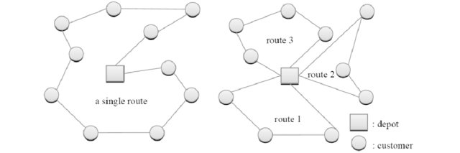
Vehicle Routing Problem (VRP)
Objective
Generate a set of routes, such that:
Minimize total cost while serving all customers
Each customer is served once by exactly one vehicle
Customer demand must not exceed vehicle capacity
Each route starts and ends at the depot
Features
Solution Shape: Νode permutations each starting and ending at the depot
Solution Initialization: Depot insertion for both permutations
Selection Criterion:
At each iteration, insert the arc which
Starts from the last nodes of the given routes
Ends at a customer not violating any problem constraint
Minimizes the corresponding cost
Dantzig and Ramser introduced the Truck Dispatching Problem (1959)
VRP is a generalization of Traveling Salesman Problem (TSP)

Slide 4
Clustered Vehicle Routing Problem
Objective
In CluVRP, customers are grouped into different clusters. CluVRP builds upon the standard CVRP, which involves finding the most efficient routes for vehicles to deliver to a set of customers.
Key Challenges
Cluster Integrity: A vehicle must service all customers within a cluster before moving to another.
Cluster–Route interdependence: Choice of clusters strongly affects routing cost
Each cluster and customer must be served only once.
Load balancing: Ensuring no cluster overloads a vehicle
Scalability: CluVRP is NP-hard, meaning finding the absolute optimal solution can be computationally challenging for larger problem instances.

Slide 5
Clustered Vehicle Routing Problem
Solution Approach
Solving CluVRP often involves decomposing the problem into subproblems: assigning clusters to routes, routing within each cluster, and sequencing the nodes in the routes.
Real World Application
Food Delivery
Healthcare
Distribution Networks

Slide 6
Methodology - Initial Solution
Greedy Approach
Cluster-First, Route-Second
Nearest-Neighbor over centroids
2-opt & swap to refine centroid tour
Split DP partitions the tour into feasible segments
Expand segments into full customer-level routes
Centroids
Centroid Tour
Split
Expanded Routes

Slide 7
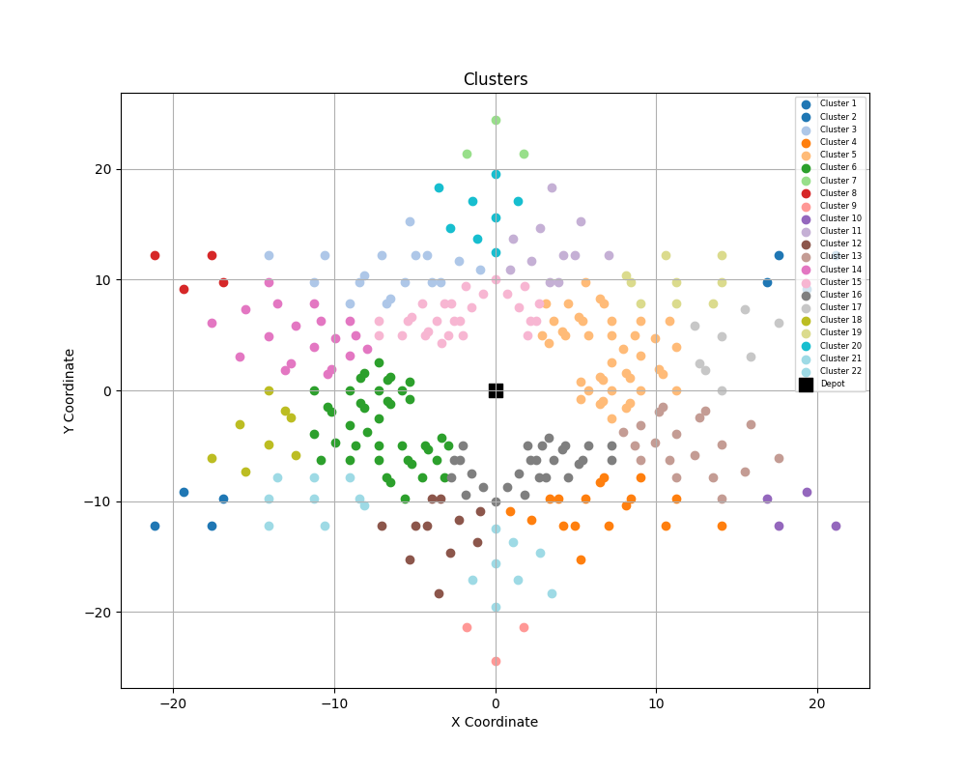
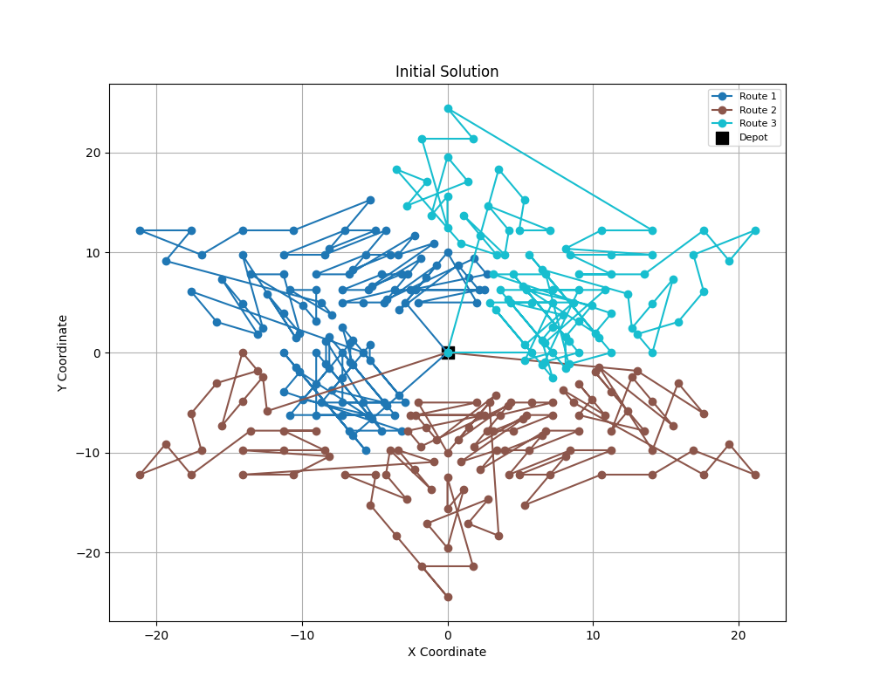
Methodology - Initial Solution

Slide 8
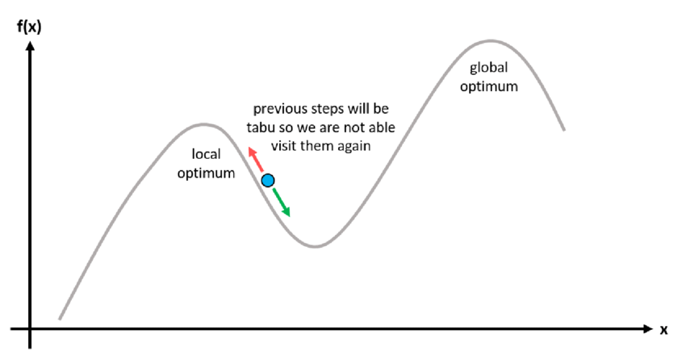
Methodology - Tabu Search Frameworks
Metaheuristics
Two variants: Classic and Adaptive Tabu Search
Shared elements: same move types (2-opt, swap), 500 iterations, candidate list

Slide 9
Classic vs Adaptive Tabu Search
CTS
Fixed tenure (each forbidden move remains tabu for several iterations)
Aspiration rule (overrides tabu status if a move results in a new global best solution)
ATS
Dynamic tenure (applies dynamic tenure, increasing with stagnation to diversify the search)
Adaptive candidate list (initialize in specific size, shrinks after improvements and expands otherwise)
Aspiration rule (gap adjusts based on progress; wider after improvements, tighter when stuck)

Slide 10
Experimental Setup
60 clustered Golden instances
Cluster size: 10–40 nodes
Customer count: 50–400
Parameters: 500 iterations, candidate size = 30, base tenure = 10
Metrics: total distance, CPU time, improvement %

Slide 11
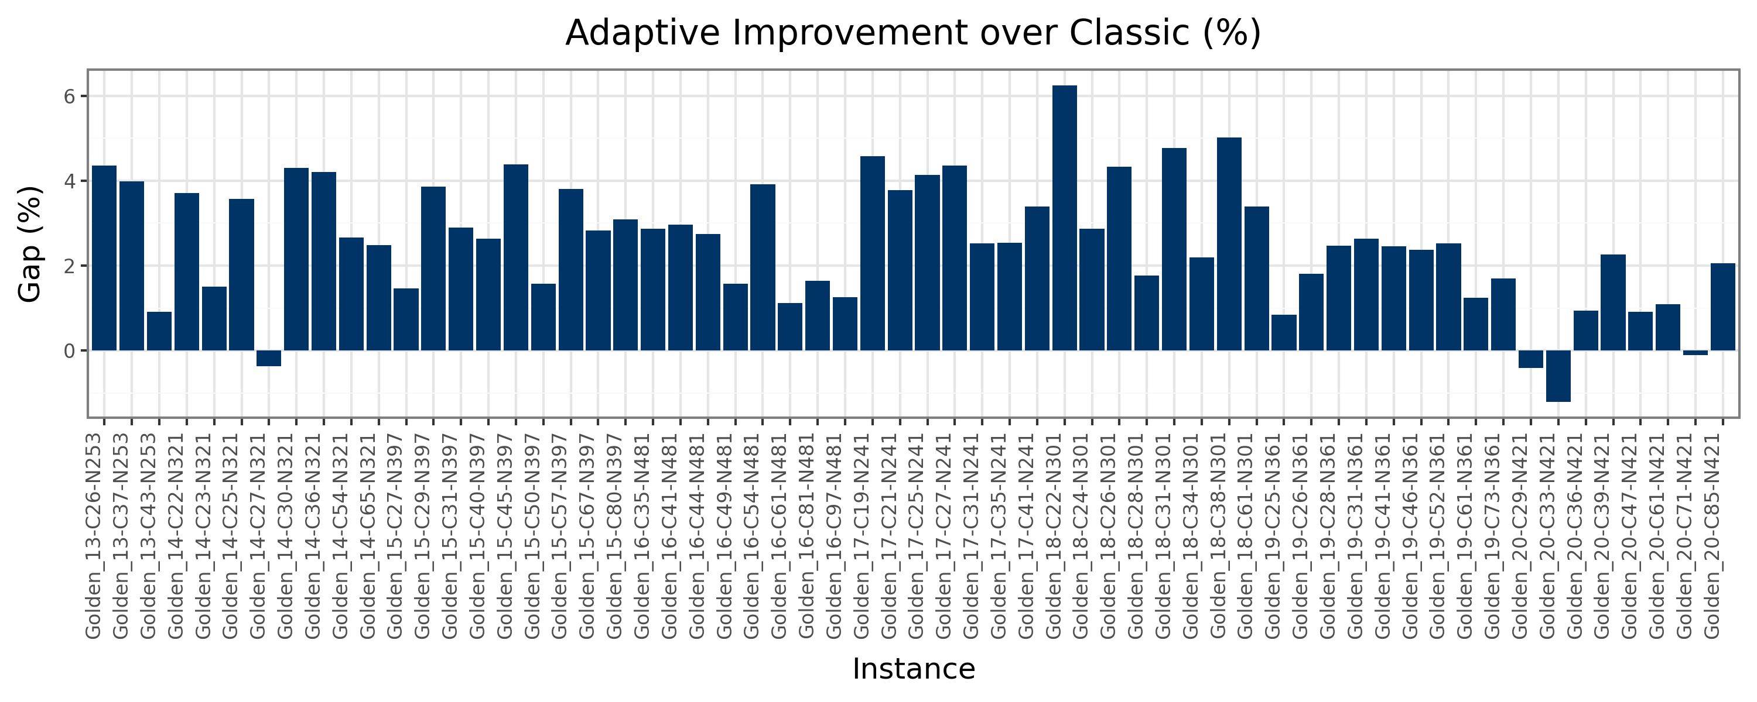
Results
ATS vs CTS
Average improvement: 2.6% shorter routes
Max improvement: 6.2%
CTS avg. time: 23.3s
ATS: 33.0s

Slide 12
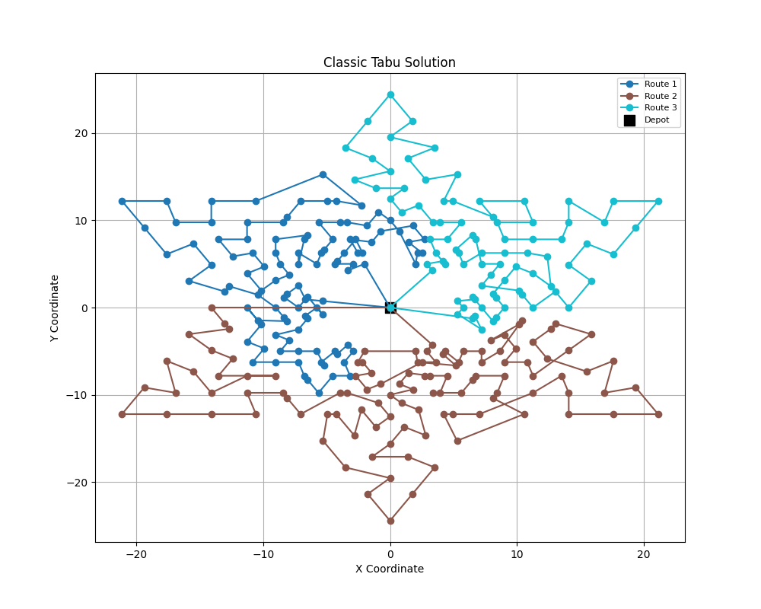
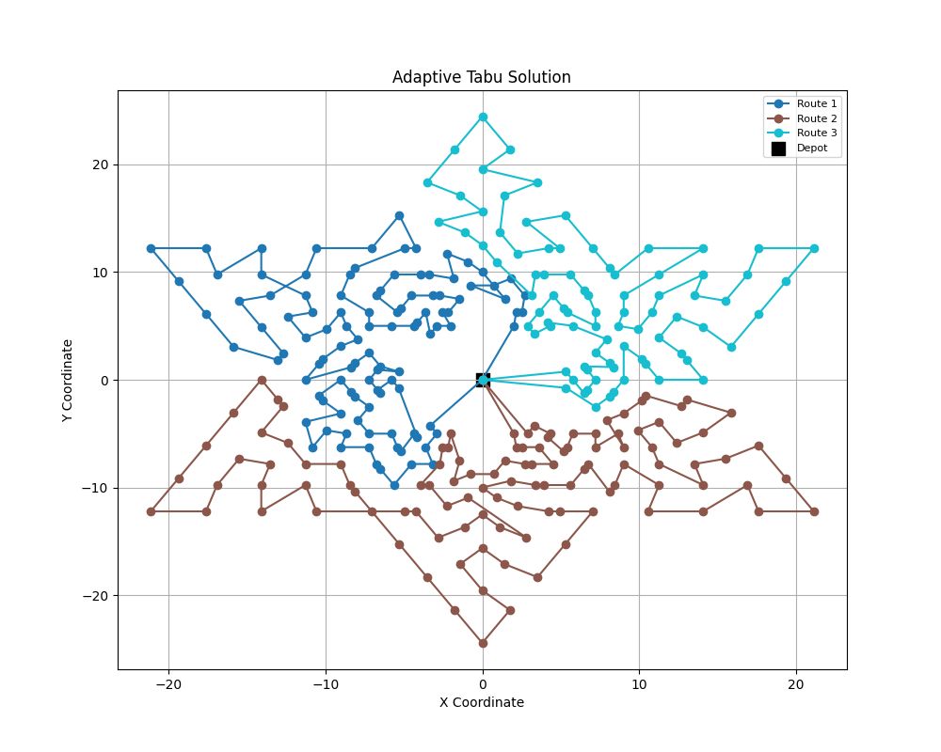
Results

Slide 13
Performance Comparison
Benchmark Studies
Battarra et al. (2014): Developed an exact branch-and-cut algorithm for CluVRP, setting many of the best-known solutions used in literature.
Islam et al. (2021): Proposed a hybrid matheuristic (based on LNS and MIP components) that improved performance on medium-to-large instances.
ATS Results
ATS reaches within -4.22% of best known on average
Best case: gap of just -0.88%
Interpretation & Significance
ATS performs competitively compared to exact methods.
Results are promising especially for scalable, real-world use where exact methods may be too slow.
Consistent improvement across all 60 instances suggests robustness.

Slide 14
Conclusion & Future Work
Conclusion
2-phase method (centroid heuristic + ATS) delivers near-optimal, scalable results.
Future Work
Add VND (Variable Neighborhood Descent)
Integrate branch-and-cut seeding
Parallelize move evaluation (multi-thread or GPU)

Slide 15
The End

